Slide 2

Technical Writing and Presentation
Passive infrared sensor dataset and deep learning model for device-free indoor localization and tracking
Nguyen Van Mung 20212894

Slide 3

Introduction
Infrared technology
Author's proposed system and data set
Data collection
Test methods
Results And Discussions
Conclusion & future work

Slide 4
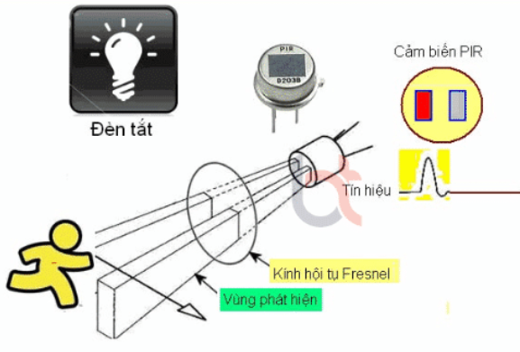
Abstract
-This article begins by highlighting how location estimation or localization is an important factor in IoT applications such as remote health monitoring and smart homes.
-Commercial passive infrared (PIR) sensors without modifications are proposed as a promising option due to their low cost, low power consumption, and good accuracy.
-Deep learning methods such as CNN, RNN, and CNN–RNN are deployed to evaluate the system and dataset
-The results demonstrate the applicability and feasibility of the system, as well as the capabilities of deep learning methods in PIR-based localization and tracking

Slide 5
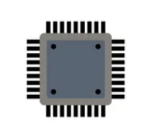

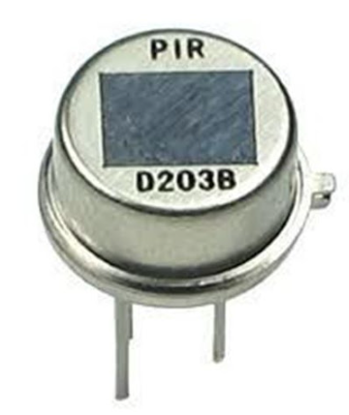
Introduction
Propose a PIR system that is compact and provides a vast data set for researchers
Low energy consumption and precise positioning
Location is an important factor in many IoT applications such as remote health monitoring and smart homes.
Evaluate my dataset using deep learning and particle filter methods, with promising results
Complex and difficult to implement, and publicly available data to evaluate methods are lacking

Slide 6

Infrared technology
-Infrared technology, such as PIR and thermopile sensors, can be used to detect movement by measuring temperature changes.
-They consume little energy, are low priced and easy to use.
-Although not as accurate as RF, they can still achieve accuracy in the sub-meter range
=>Therefore, they are a viable choice for indoor location estimation.

Slide 7
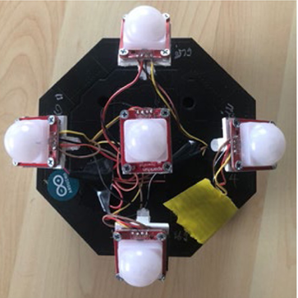
Author's proposed system and data set
Hardware and environment setup
There are three types of sensor deployment: floor-mounted, wall-mounted, and ceiling-mounted.
Choose ceiling mounting because there are no problems such as obstructed vision and tripping hazards.
Developed a ceiling-mounted sensor node with 5 PIR sensors, covering a large area.
The sensor is connected to an Arduino MEGA 2560 microcontroller to synchronize the transmission and data collection cycles.

Slide 8
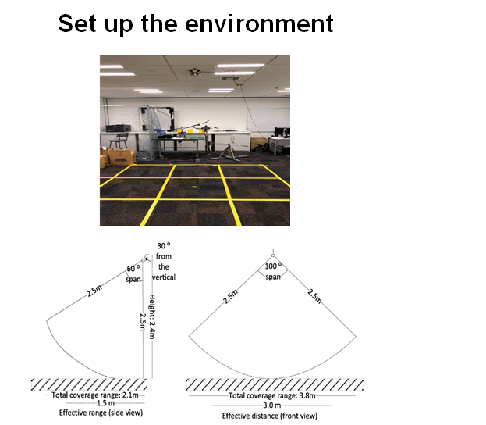
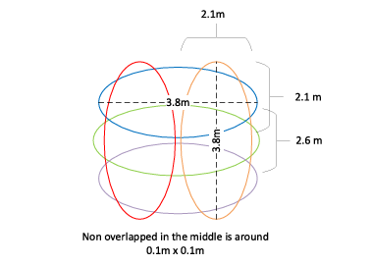
Author's proposed system and data set
-The sensor node is mounted on the ceiling in an open office area where the ambient temperature is regularly controlled.
-The monitoring area is set up as a square with dimensions of 3m x 3m to ensure enough area for PIR sensors.

Slide 9
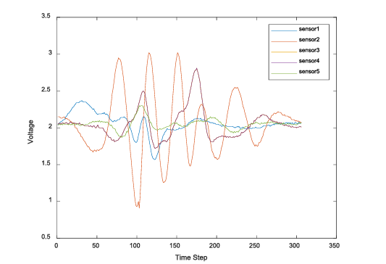
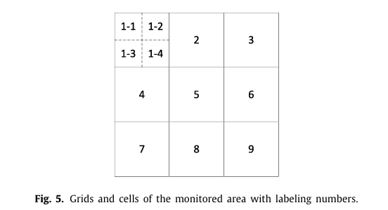
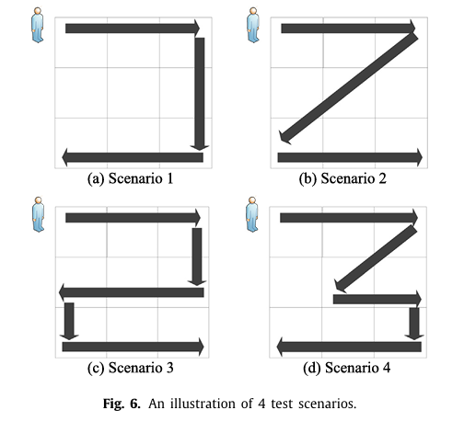
Data collection

Slide 10
Test methods
The authors research and test many deep network architectures to classify moving people's locations based on infrared signal data.
They use CNN, RNN, and combinations of them for testing
The data is processed using a threshold to detect movement.
Then, select only the parts of the corresponding signal for position classification.
The data is processed using a threshold to detect movement.
Deep network architectures are trained and evaluated through cross-validation method

Slide 11
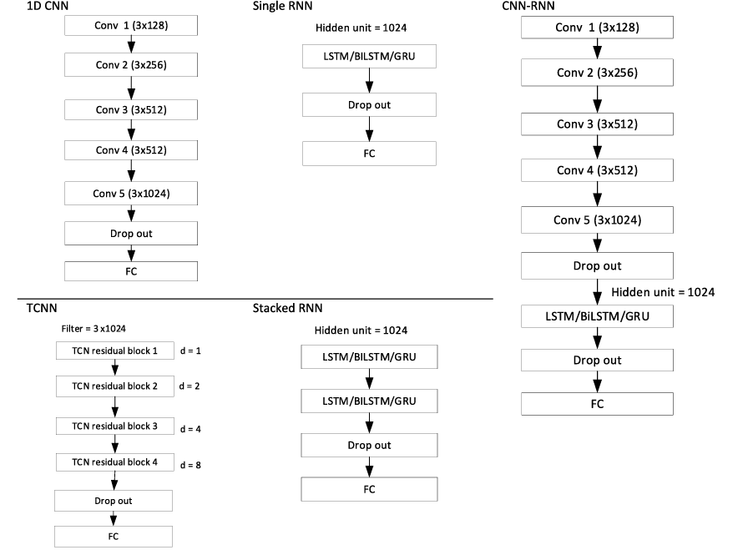
Test methods

Slide 12
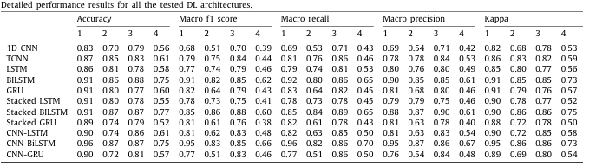
Results And Discussions
Cell classification results:
-The CNN–BiLSTM model achieved the highest accuracy of 85% and kappa score of 0.841.
-The BiLSTM model also showed the best results compared to other RNN models, with an accuracy of 84% and a kappa score of 0.835.
-Scenario 4 poses many challenges due to the random pattern of the PIR output, which reduces the performance of the TCNN model.
Results of estimating 2D coordinates:
The CNN–BiLSTM model showed the best results with an accuracy of 85% and a kappa score of 0.841.
The CNN-LSTM and CNN-GRU models generally perform worse than the superimposed LSTM and GRU models, except in the case of scenario 2.

Slide 13
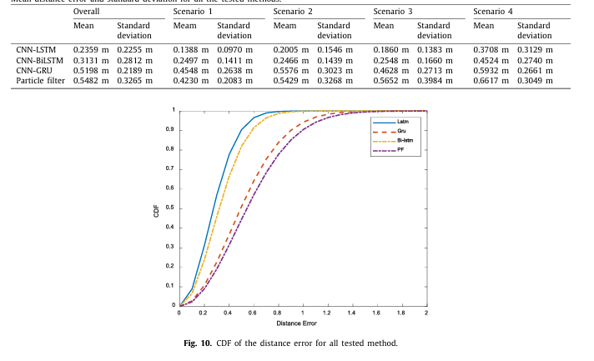
Results And Discussions
-Ambiguous signals: The deep learning model has difficulty distinguishing locations because the PIR signal is similar in many locations. -Unfeasible position: Impossible position estimation may occur, requiring motion information to improve accuracy.
-Unwanted signal patterns: Models that are difficult to predict from unwanted signal patterns, need more flexible models.
-Sequence length: Sensor data sends part of the time, making location prediction difficult.
-Other methods: In addition to sequence classification, there are also methods that convert PIR signals into images and use deep learning models.
-Scalability: It is necessary to increase the number of sensor nodes and consider factors such as reporting frequency to improve the scalability of the system.

Slide 14
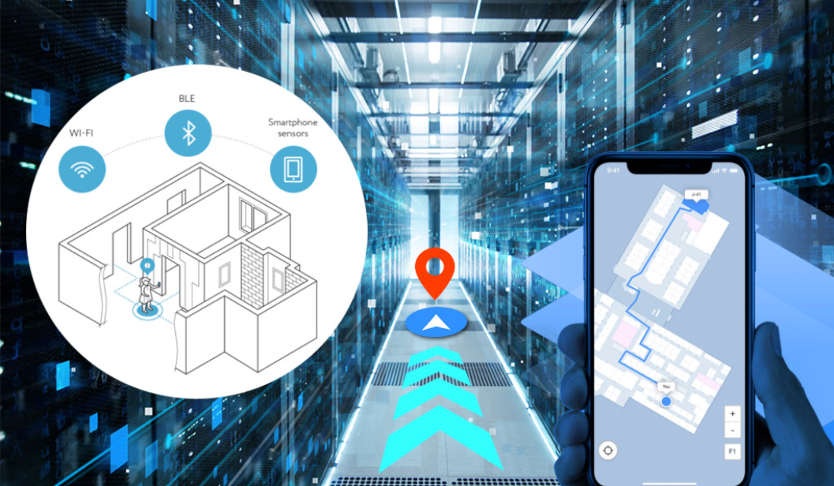
Conclusion & future work
-Proposes a Passive Infrared sensor system and provides a data set for indoor positioning and tracking. Our sensor node is developed based on commercially available sensors. Our dataset includes 1,000 walking samples, 4 scenarios, and a total of 36 classes.
-In the future, we aim to improve the scalability of the proposed system. In addition, we will increase the variety of our dataset. more scenarios will be included, especially with multiple persons. Different topologies of sensor deployment

Slide 15
THANK YOU !

